Slide 1


Slide 2
C: How Did We Get Here?
What if this is as good as it gets?

Slide 3
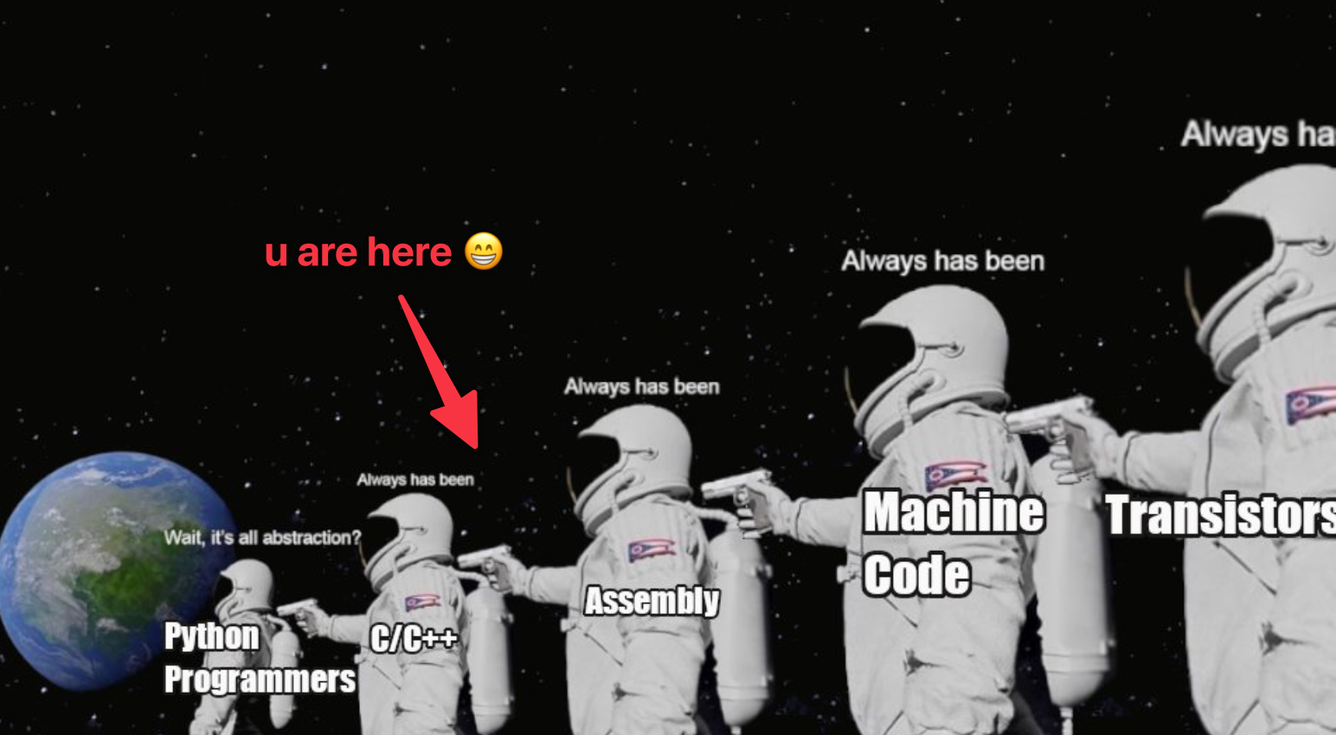
Syllabus

Slide 4
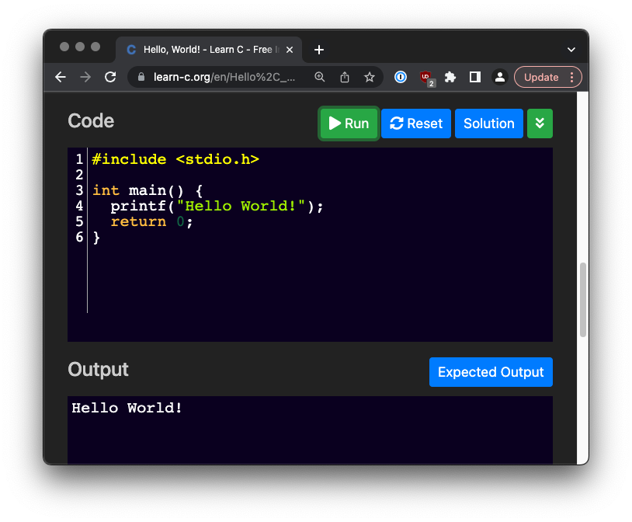
Today’s Lecture
A history of the C programming language
Why did C win?
Why are we still using C?
How is C easy?
How is C hard?
Notes:
Can be found online… but I can’t link to it

Slide 5
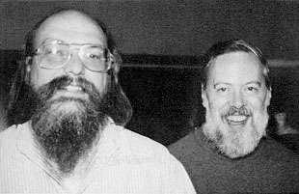
Panic Learning C
https://www.learn-c.org
https://www.learn-c.org/en/Hello%2C_World%21
https://www.learn-c.org/en/Variables_and_Types
https://www.learn-c.org/en/Conditions
https://www.learn-c.org/en/For_loops
https://www.learn-c.org/en/While_loops
Notes:
Can be found online… but I can’t link to it

Slide 6
The History of C
Invented by Dennis Ritchie in 1972
Successor to the B programming language
Yes, there is an unrelated D programming language
Designed to help build the original Unix OS
Pictured: Ken Thompson, Dennis Ritchie
Notes:
Can be found online… but I can’t link to it

Slide 7
The C Programming Language
Dennis Ritchie died in 2001 “Ritchie was under the radar. His name was not a household name at all, but... if you had a microscope and could look in a computer, you'd see his work everywhere inside.”
Notes:
Can be found online… but I can’t link to it

Slide 8
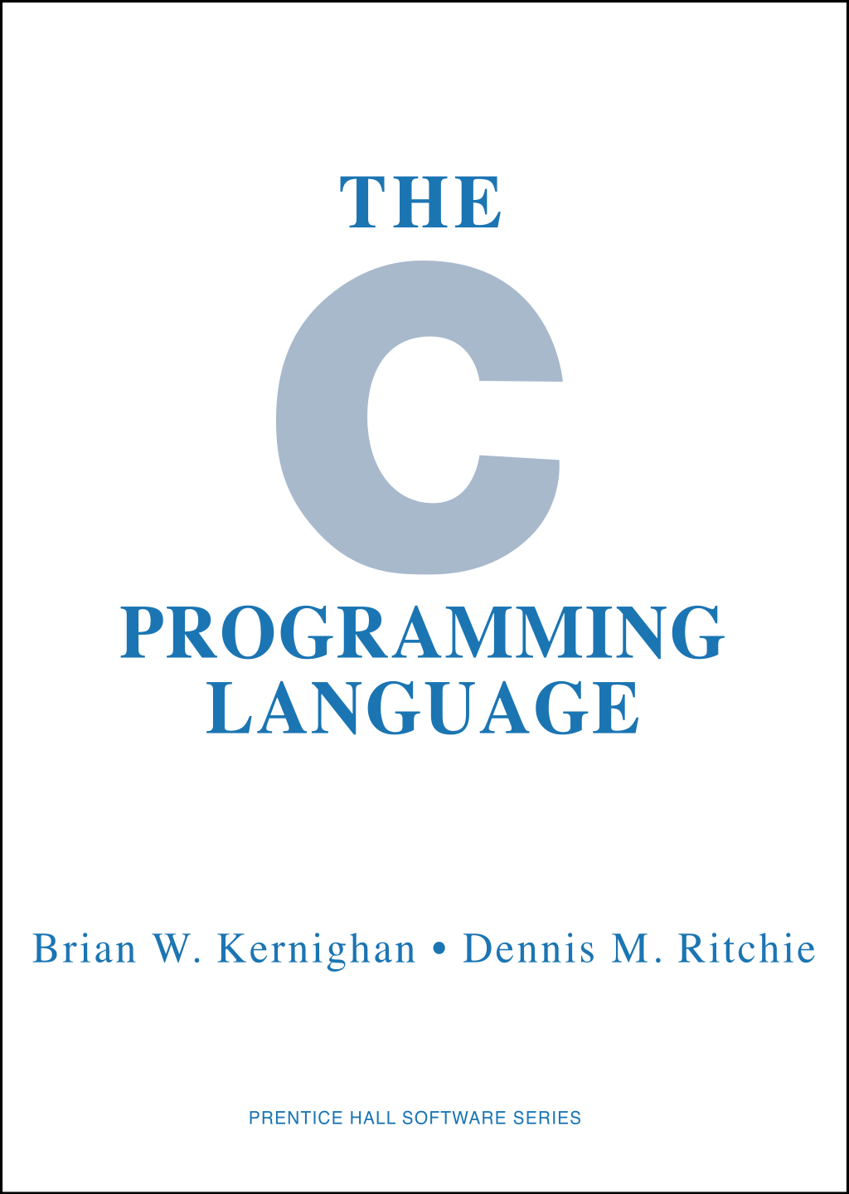
The C Programming Language
Hugely influential language
A sampling of languages derived from it:
Java
C++
Javascript
Typescript
D
C#
Notes:
Can be found online… but I can’t link to it

Slide 9
The C Programming Language
Included many features that today we consider standard, if we even think about them at all
Recursion
Statically typed
Lexical scoping of variables
Notes:
Can be found online… but I can’t link to it

Slide 10
The C Programming Language
What was “the big idea” with C?
Programming in assembly was hard especially as program size grew
No notion of variables with names
No notion of scoping
Implicit “parameters” and lots of busywork around function calls
Notes:
Can be found online… but I can’t link to it

Slide 11
The C Programming Language
C provided a lot of nice features on top of assembly:
Easy function definition
Easy function invocation, including argument passing
Scoped local variables
Implicit stack pointer & register management
No more function prolog or epilog
Notes:
Can be found online… but I can’t link to it

Slide 12
The C Programming Language
C rapidly took over in place of assembly for general purpose development
Assembly, by and large, has been relegated to special situations like embedded or extremely perf-sensitive work
Notes:
Can be found online… but I can’t link to it

Slide 13
The C Programming Language
C, invented in 1972 (half a century ago!) is still widely used in industry
Linux kernel development, and nearly all operating systems work, is done in C with bits of assembly
Notes:
Can be found online… but I can’t link to it

Slide 14
The C Programming Language
C is still used heavily in embedded systems
Many of the core server systems of internet-based systems are written in C:
DBMS (e.g. PostgreSQL)
Web Servers (e.g. nginx)
DNS (BIND)
Notes:
Can be found online… but I can’t link to it

Slide 15
The C Programming Language
Many user applications are still written in C or a mix of C and other libraries
Almost all the core unix utilities are written in C
Almost all the other programming languages are written in C
Python
Java
Notes:
Can be found online… but I can’t link to it

Slide 16
The C Programming Language
What’s the deal with C?
Why are we still using it half a century later?
Notes:
Can be found online… but I can’t link to it

Slide 17
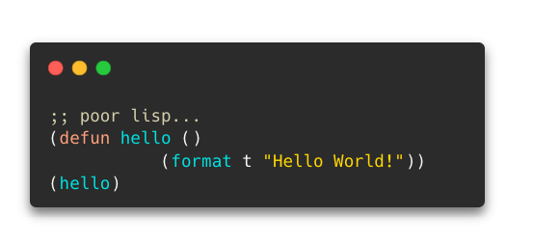
The C Programming Language
Where there any other alternatives?
Yes! The“other” big language in the 70’s & 80s: Lisp
Lisp could not be more different than C!
Notes:
Can be found online… but I can’t link to it

Slide 18
The C Programming Language
Lisp has the following features:
It’s garbage collected
Yes, back in the 70s!
It has a much larger/nicer standard library
It is memory safe
Id doesn’t require header files
It can even call into C when necessary pretty easily!
Notes:
Can be found online… but I can’t link to it

Slide 19
The C Programming Language
Lisp was a far more advanced programming language than C!
It was also very popular in the early AI community due to its flexibility & metaprogramming
Maybe you’ve heard of AI?
So… why didn’t lisp win?
Notes:
Can be found online… but I can’t link to it

Slide 20

The C Programming Language
A Lisp enthusiast, Richard Gabriel, tried to make sense of the situation
A portion of his paper has come to be known as the “Worse Is Better” argument:
https://dreamsongs.com/RiseOfWorseIsBetter.html
Notes:
Can be found online… but I can’t link to it

Slide 21
The C Programming Language
In this paper he contrasts two styles:
The MIT/Stanford approach
The Bell Labs/Berkeley approach
MIT/Stanford focuses on “the right thing” no matter the complexity cost
New Jersey/Berkeley focuses on simplicity of implementation
Notes:
Can be found online… but I can’t link to it

Slide 22
The C Programming Language
He contrasts theses styles along four possible design goals:
Simplicity of implementation
Correctness of implementation
Consistency of system
Completeness of systems
Notes:
Can be found online… but I can’t link to it

Slide 23
MIT/Stanford
Simplicity -- the design must be simple, both in implementation and interface. It is more important for the interface to be simple than the implementation.
Notes:
Can be found online… but I can’t link to it

Slide 24
MIT/Stanford
Correctness -- the design must be correct in all observable aspects. Incorrectness is simply not allowed.
Notes:
Can be found online… but I can’t link to it

Slide 25
MIT/Stanford
Consistency -- the design must not be inconsistent. A design is allowed to be slightly less simple and less complete to avoid inconsistency. Consistency is as important as correctness.
Notes:
Can be found online… but I can’t link to it

Slide 26
MIT/Stanford
Completeness -- the design must cover as many important situations as is practical. All reasonably expected cases must be covered. Simplicity is not allowed to overly reduce completeness.
Notes:
Can be found online… but I can’t link to it

Slide 27
New Jersey/Berkeley
Simplicity -- the design must be simple, both in implementation and interface. It is more important for the implementation to be simple than the interface. Simplicity is the most important consideration in a design.
Notes:
Can be found online… but I can’t link to it

Slide 28
New Jersey/Berkeley
Correctness -- the design must be correct in all observable aspects. It is slightly better to be simple than correct.
Notes:
Can be found online… but I can’t link to it

Slide 29
New Jersey/Berkeley
Consistency -- the design must not be overly inconsistent. Consistency can be sacrificed for simplicity in some cases, but it is better to drop those parts of the design that deal with less common circumstances than to introduce either implementational complexity or inconsistency.
Notes:
Can be found online… but I can’t link to it

Slide 30
New Jersey/Berkeley
Completeness -- the design must cover as many important situations as is practical. All reasonably expected cases should be covered. Completeness can be sacrificed in favor of any other quality. In fact, completeness must be sacrificed whenever implementation simplicity is jeopardized. Consistency can be sacrificed to achieve completeness if simplicity is retained; especially worthless is consistency of interface.
Notes:
Can be found online… but I can’t link to it

Slide 31
New Jersey/Berkeley
Gabriel argues that, despite his biases, the Worse Is Better approach taken by C has better survival characteristics
This is a wonderful example of a person reasoning against their priors
Notes:
Can be found online… but I can’t link to it

Slide 32
New Jersey/Berkeley
Wrote a series of papers essentially arguing with himself as to whether Worse Is Better
https://dreamsongs.com/Files/worse-is-worse.pdf
https://dreamsongs.com/Files/IsWorseReallyBetter.pdf
Notes:
Can be found online… but I can’t link to it

Slide 33
New Jersey/Berkeley
I agree that, in some cases, and certainly in the case of C, Worse is/was Better
Simplicity of implementation is an important design consideration and other considerations may need to be subordinated to it
“80/20” thinking
Notes:
Can be found online… but I can’t link to it

Slide 34
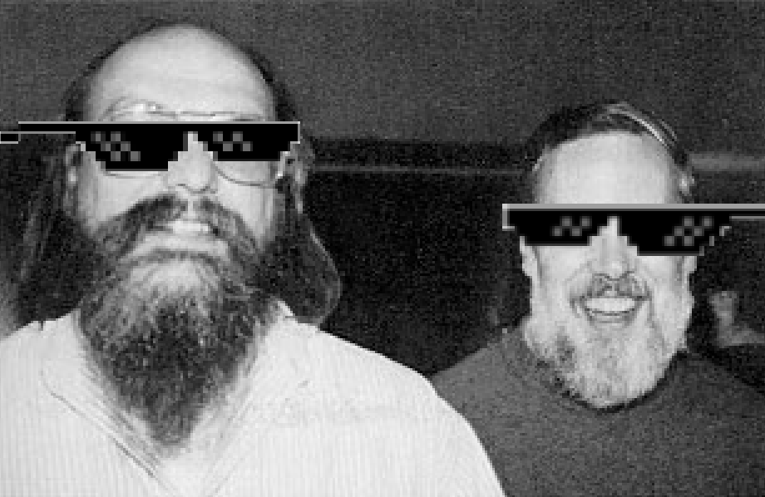
The C Programming Language
C was/is “Worse is Better”
It won
Nothing has really replaced it for systems programming
Maybe Rust?
Maybe
Deal with it…
Notes:
Can be found online… but I can’t link to it

Slide 35
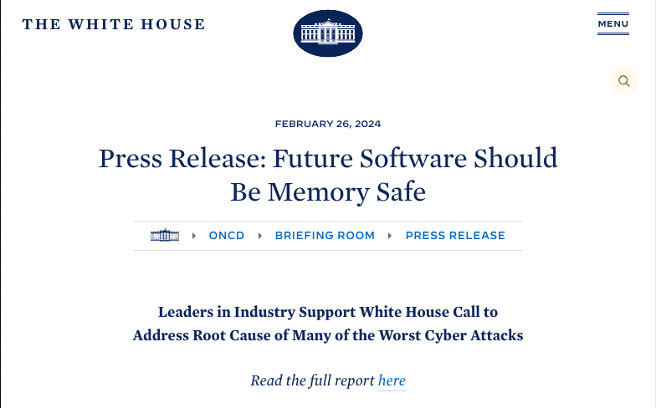

Slide 36
LMAO

Slide 37
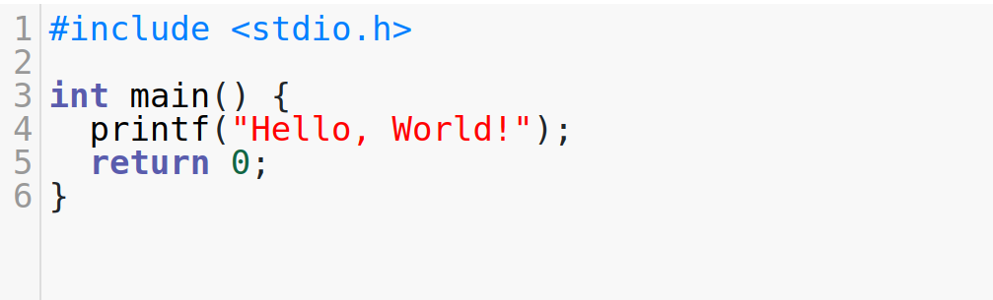
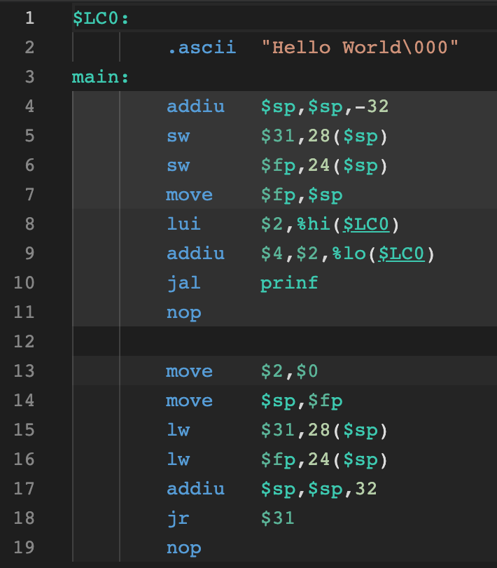
The C Programming Language
C is a link between high-level programming concepts, like functions and low-level hardware concepts, like registers
It abstracts away the machine instructions, letting programmers work at a higher level of abstraction than assembly
Notes:
Can be found online… but I can’t link to it

Slide 38
The C Programming Language
At right is the canonical “Hello World” program in C, compiled into MIPS assembly
Note the explicit stack management and register juggling in the assembly
Compare with the simplicity of the C program
Easy to see why C got popular!
Notes:
Can be found online… but I can’t link to it

Slide 39
Macros In C
What about that #include at the start of the program?
In c, #include is a macro
A macro is a bit of code that is executed at compile time
The result of that code execution is then substituted for the macro text and then compilation begins
Notes:
Can be found online… but I can’t link to it

Slide 40
Macros In C
#include angle brackets vs. strings
#include <foo.h> // look for foo.h on system path
#include “foo.h” // look for foo.h in the current directory, then the system path
Notes:
Can be found online… but I can’t link to it

Slide 41
Header Files
The header file concept is important in C because, in C, you cannot use a function or variable unless it has been declared
NB, this doesn’t mean defined, only declared
Header files allow you to declare features so other files can refer to them
Notes:
Can be found online… but I can’t link to it

Slide 42
Header Files
There is nothing magic about header/.h files: they are just a convention built on top of the fact that C lets/requires you split declarations and definitions up
Worse is better
Notes:
Can be found online… but I can’t link to it

Slide 43
Header Files
There is no name-spacing in header files or .c files
One giant global namespace
Compare with Java, where you have packages
Prefixing functions is common to achieve namespacing
Worse is better
Notes:
Can be found online… but I can’t link to it

Slide 44
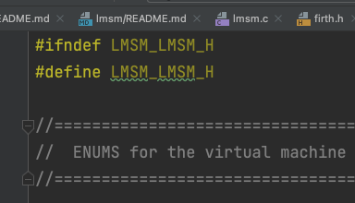
Macros In C
At the top of header files you often see this #ifndef macro
Why?
Notes:
Can be found online… but I can’t link to it

Slide 45
Macros In C
Again, in C, macros are straight string substitution, so the header files are directly injected into the C file
If two header files referred to one another without this check, you’d have an infinite loop of inclusion
Worse is better is worse?
Notes:
Can be found online… but I can’t link to it

Slide 46
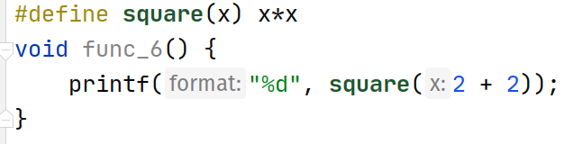
Macros In C
You can define your own macros in C using the #define macro
Here we create a square() “method” using #define
This will string substitute x*x for x
A faster square function since the logic is inlined!
What does this print?
Notes:
Can be found online… but I can’t link to it

Slide 47
Macros In C
Oops
The problem is that string substitution here gives us 2 + 2 * 2 + 2
Which binds as 2 + (2 * 2) + 2
Macros are dangerous and can lead to very hard to understand bugs and code
Notes:
Can be found online… but I can’t link to it

Slide 48
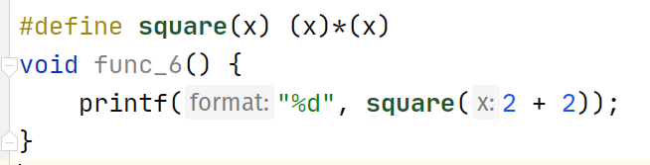
Macros In C
Oops
The problem is that string substitution here gives us 2 + 2 * 2 + 2
Which binds as 2 + (2 * 2) + 2
Worse is better
Notes:
Can be found online… but I can’t link to it

Slide 49
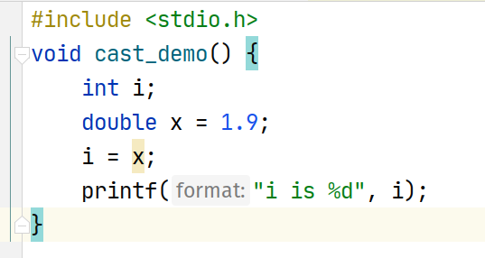
Data Types In C
Common C Data Types
int - usually means a 32 bit integer
long long - a 64 bit integer
unsigned long long - an unsigned 64 bit integer
char - 8 bit integer, represents a character (usually)
float - 32 bit floating point decimal number
double - 64 bit floating point decimal number
Notes:
Can be found online… but I can’t link to it

Slide 50
Data Types In C
C is relatively permissive in allowing casting between different data types
What do you think this code prints?
Notes:
Can be found online… but I can’t link to it

Slide 51
Javascript Is Easy, Right?
JavaScript, in contrast with C, only has one core numeric type: Number
Easy, right?
Notes:
Can be found online… but I can’t link to it

Slide 52
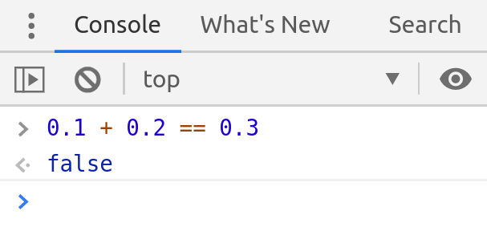
Javascript Is Easy, Right?
JavaScript, in contrast with C, only has one core numeric type: Number
Easy, right?
Notes:
Can be found online… but I can’t link to it

Slide 53
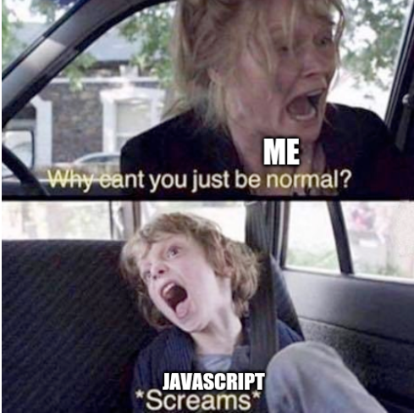
Javascript Is Easy, Right?
JavaScript, in contrast with C, only has one core numeric type: Number
Easy, right?
Notes:
Can be found online… but I can’t link to it

Slide 54
Function Definitions
A thing to really appreciate about C is how clean and understandable function declarations are
C is a functional programming language
Not a fancy one, like Haskell or OCaml, but still!
Notes:
Can be found online… but I can’t link to it

Slide 55
Function Definitions
The syntax has been hugely influential:
The function return type, followed by function name, followed by argument list
Arguments are comma separated and declared the familiar type name format
Curly braces around function body
This syntax influenced many later languages (e.g Java)
Notes:
Can be found online… but I can’t link to it

Slide 56
C Standard Library
The code at right also demonstrates calling a library function, printf()
This was another big contributor to the growth of C: especially on unix, it came with a standard library for things like I/O
Seems obvious today, but a big deal back then!
Notes:
Can be found online… but I can’t link to it

Slide 57
C Standard Library
Let’s take a look at the signature for printf()...
Notes:
Can be found online… but I can’t link to it

Slide 58
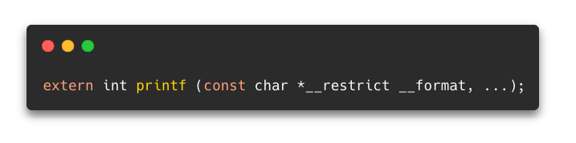
C Standard Library
Let’s take a look at the signature for printf()
Uhhh, what?
This method signature shows how C can be hard…
Notes:
Can be found online… but I can’t link to it

Slide 59
C Standard Library
Ignore the extern
printf takes a pointer to a char
const - “Compiler, I will not assign a new value to this variable name”
__restrict - “Compiler, I will only use this pointer to access this data”
Notes:
Can be found online… but I can’t link to it

Slide 60
C Standard Library
This is definitely Worse Is Better
A “good” language would abstract this away
E.g. provide a good String abstraction
But, say what one will, C won and has shown tremendous staying power as a systems language
Notes:
Can be found online… but I can’t link to it

